Slide 1
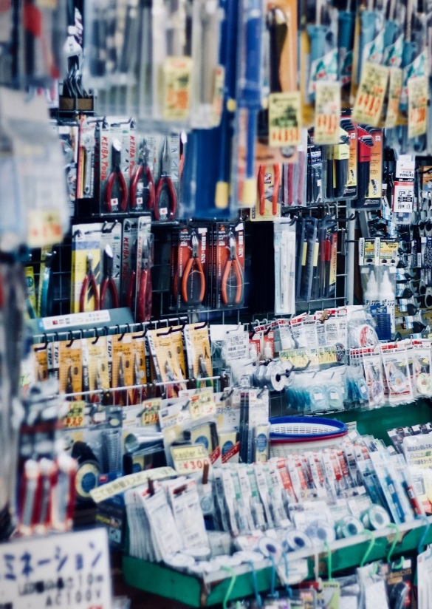
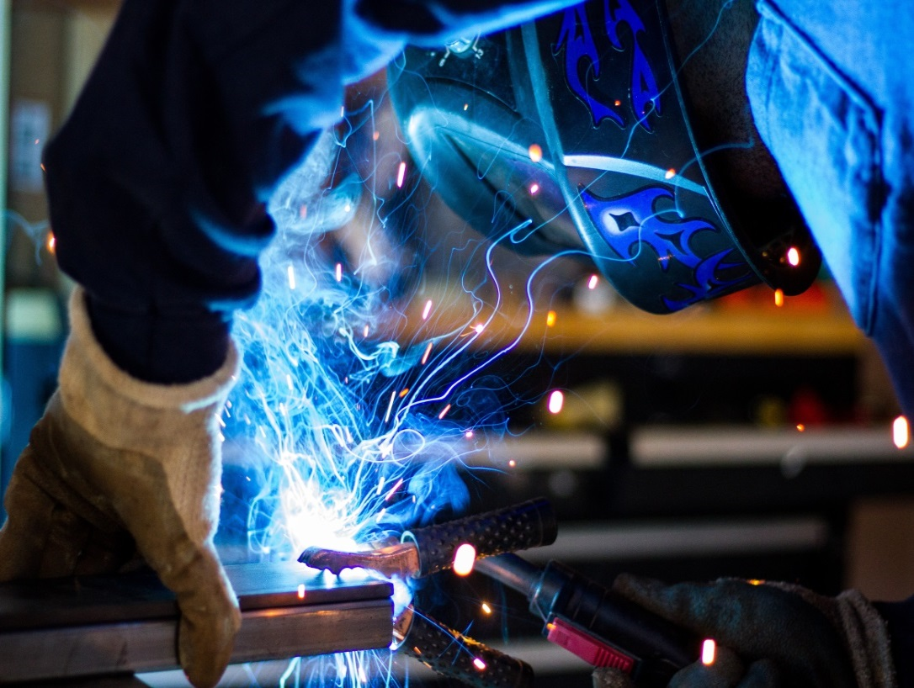
(PTY) LTD
COMPANY PROFILE

Slide 2
About Us
Midway General Supplies is a retailer of a full range of Hardware, Tools, Mechanical & Electrical Equipment, Welding Equipment, Steel and associated products.
We carry an in-depth quality product range at the most competitive prices.
Our safety division includes Overalls, Dustcoats, Safety Boots, Gloves, Spectacles, and all related safety products.
We strive for excellence not only in our products, but also in our services.
We have a vast amount of experience in the fields we represent and the level of expertise in our staff is one of our biggest assets.
"If everyone is moving forward together, then success takes care of itself." --Henry Ford

Slide 3
Our Values
Integrity
We are honest and ethical. Our clients trust us to adhere to our word.
“VALUES
MATTER”
Commitment
Delivering our very best in all we do to grow a business that we can be proud of.
Diversity
It is with different ideas, strengths and cultural backgrounds that our company succeeds.
"Stop chasing the money and start chasing the passion.“ Tony Hsieh

Slide 4
Our
MISSION
Our Employees
We are committed to provide our Employees with a trust worthy, stable work environment and to provide them with equal opportunity for learning and personal growth. Ideally, the
opportunity to benefit from mutual growth and success
Our Customers
We strive to provide quality branded products and services that will improve the lives of our customers.
Our Investors
We have committed to continually initiate diverse growth strategies that will enable us to deliver the kind of results on the bottom line that our investors expect and deserve.
Our Environment
We strive to serve our country and improve our environment by creating work opportunities that will enable economic growth through infrastructure development.

Slide 5
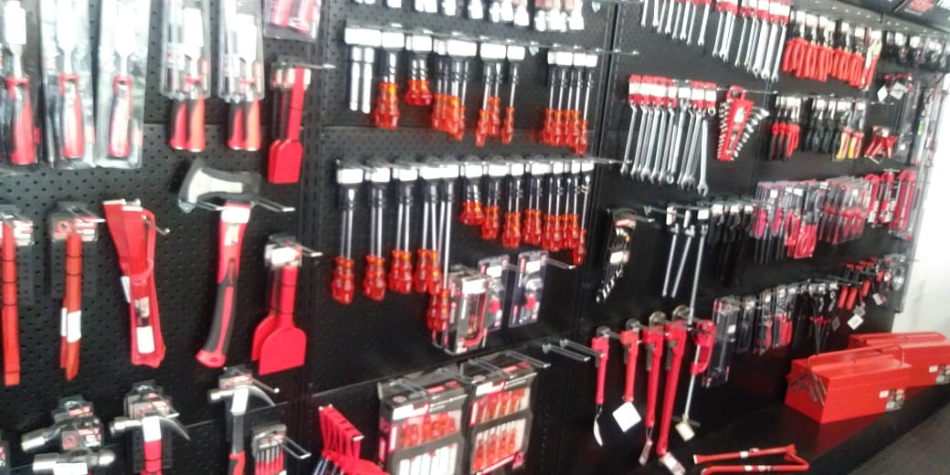
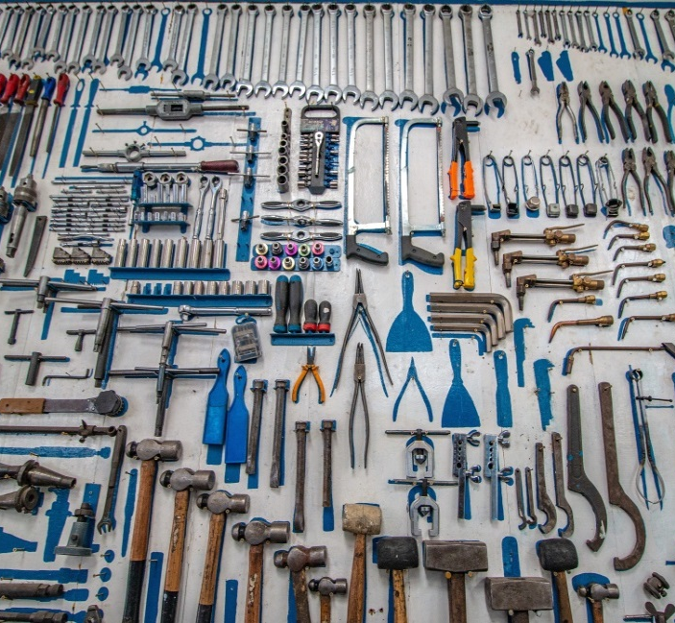
Our Product Range
Hand Tools
Cutting Tools
Power Tools
Builders Tools
Workshop Equipment
Abrasives
Oils and Lubricants
Lifting Equipment
Safety Clothing & Equipment
Electrical Equipment & Cables
Spares
Welding Equipment
Steel Products
Fasteners
Tyres
Generators

Slide 6
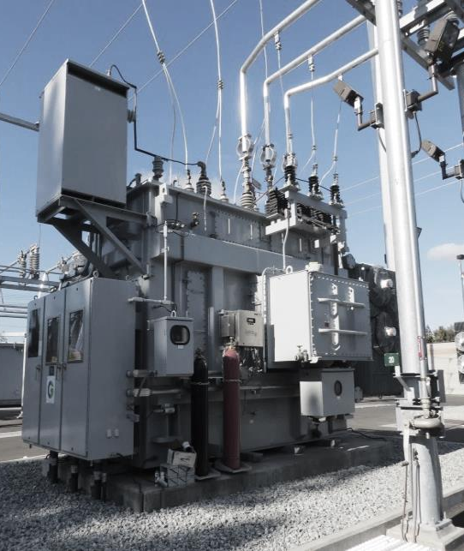
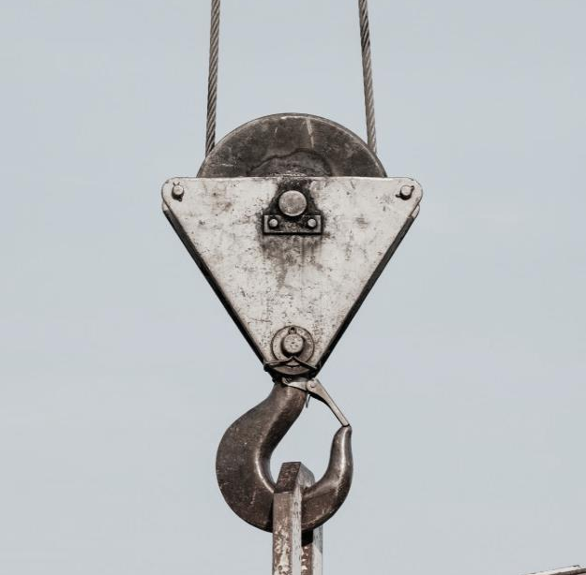
Our Services
Testing of Lifting Equipment
Mechanical Maintenance
Civil & Concrete Works
Electrical Maintenance
Low & High Voltage
Water Piping Works
Steel & Structural Works

Slide 7
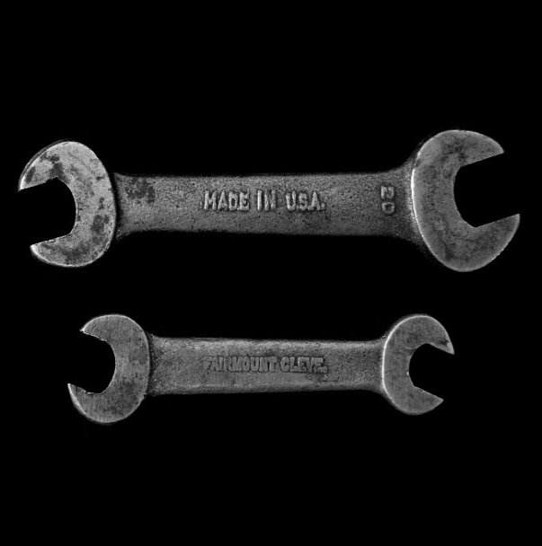
Company Details
Postal Address
PO BOX 814 – LEPHALALE - 0555
Physical Address
2C MAGOL STREET – LEPHALALE – 0557
Contact Details
MANAGEMENT - MARIUS BENADE – 076 272 6490- marius@lmgs.co.za
IVAN MEYER – 082 456 7247- ivan@lmgs.co.za
RETAIL STORE - LEPHALALE – 014 763 3900 – vicky@lmgs.co.za
Company Reg No:2015/414377/07
VAT Reg No: 4850278880
BBBEE Level 4
Directors / Partners
MARIUS BENADE – IVAN MEYER

Slide 8
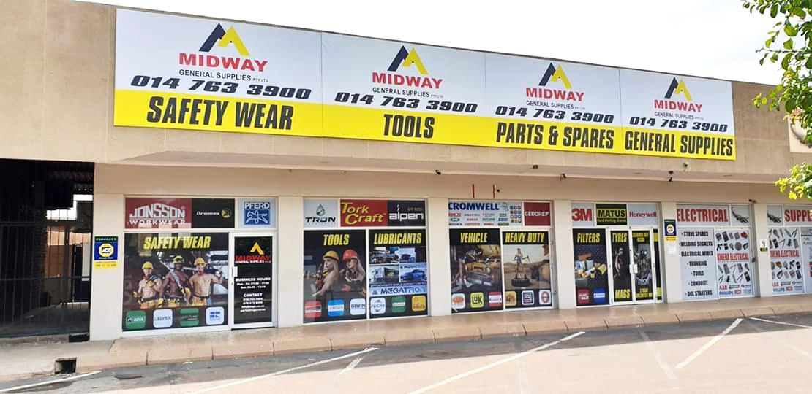
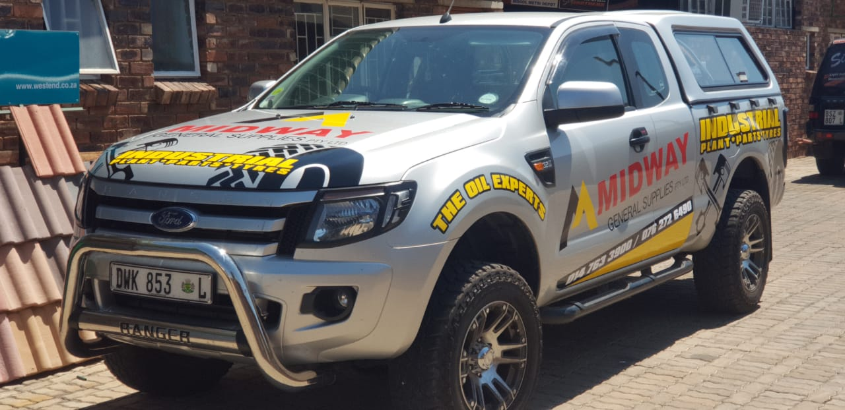
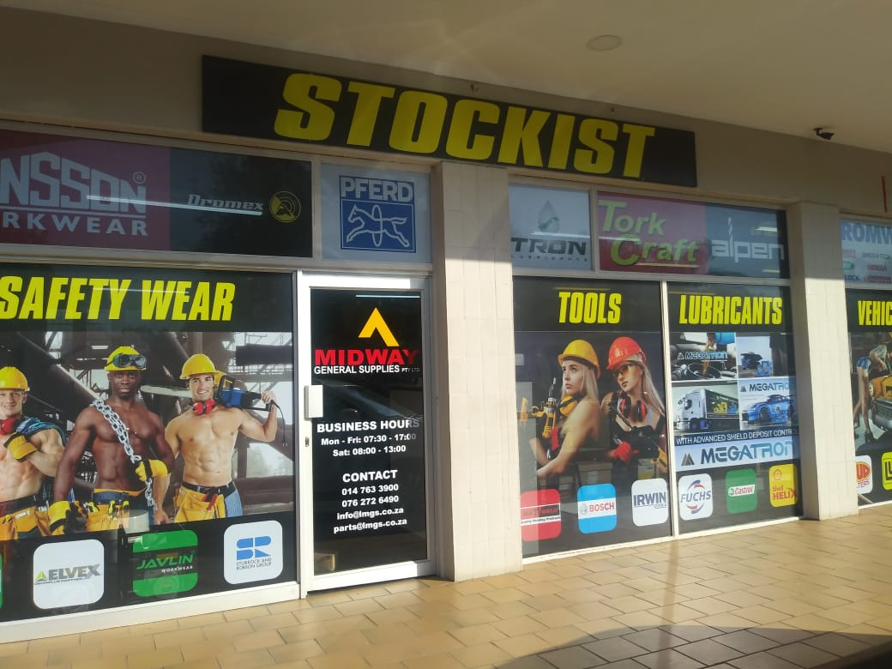
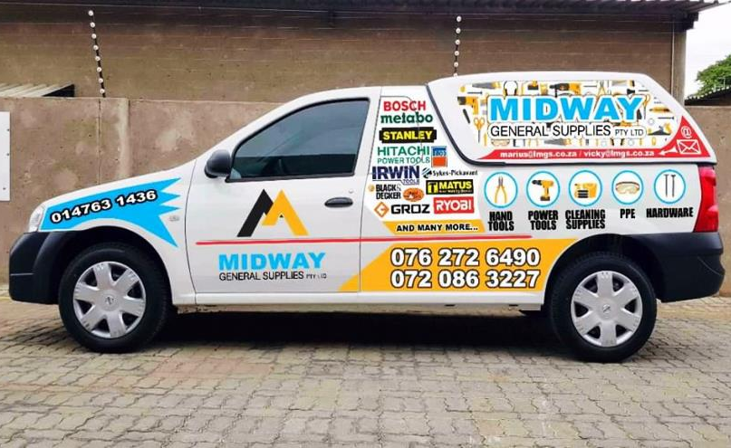
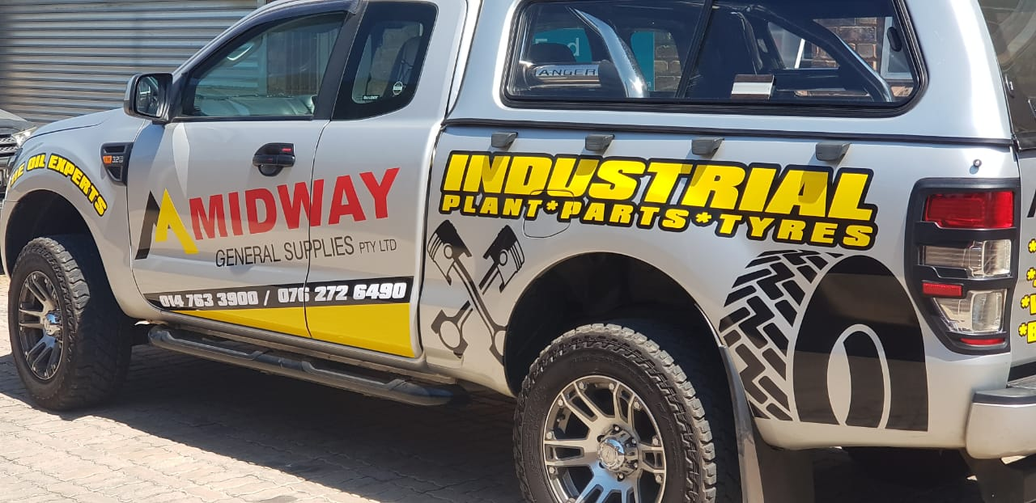
We invite you to visit our Shop
2C MAGOL STREET – LEPHALALE – 0557

Slide 9
Thank You

